Slide 1
Water routine app
Track and Optimize Your Daily Water Intake

Slide 2
NAME | SURNAME | STUDENT NUMBER
Zintle | Mandlenkomo | 222086416
Lisakhanya | Twana | 221161880
Yandisa | Mbentsula | 222710357
Sisikelelwe | Holi | 222319194
Mduduzi | Mkhwanazi | 221480188

Slide 3
introduction
the Water Routine App—a tool designed to help users manage their daily water intake effectively.Staying hydrated is crucial for overall health. Our team used Java for the initial development and later converted it to MIPS, optimizing the app for specific performance requirements. We will walk you through the challenges we identified, the tools and technologies we employed, and the innovative solutions we provided to address these challenges.

Slide 4
PROBLEM IDENTIFIED
In today's fast-paced world, maintaining proper hydration is a challenge for many people. Despite knowing the importance of drinking enough water, many of us struggle to keep track of our daily intake, leading to potential health risks.
Common issues: Forgetting to Drink Water
: Overhydration or Underhydration
: Health Risks

Slide 5
Tools used
Programming languages
- Java: Initial development of the app
- MIPS Assembly Language: Conversion of the app to MIPS for specific
performance or hardware requirements

Slide 6
Solutions
Our Water Routine App offers a comprehensive solution to the challenges of staying properly hydrated throughout the day.
Features:
User Input: The app allows users to log their water intake at four critical times of the day—morning, afternoon, evening and night. This structured approach ensures that users can easily track their hydration throughout the day.
Customized Daily Water Intake Goal: The app calculates a personalized daily water intake goal based on individual the amount of water that the user take trough the day. This ensures that the recommended intake is tailored to the user's specific needs.
Alerts and Notifications: The app sends reminders to drink water and provides alerts if the user is falling short or exceeding their daily goal. This helps users stay on track and avoid both underhydration and overhydration.

Slide 7
conclusion
Our Water Routine App effectively addresses the challenge of maintaining proper hydration in a simple way. By tracking water intake and providing personalized feedback, the app helps users stay on top of their daily hydration goals, promoting better health.We've utilized both Java and MIPS to ensure the app is efficient and adaptable to various platforms.

Slide 8
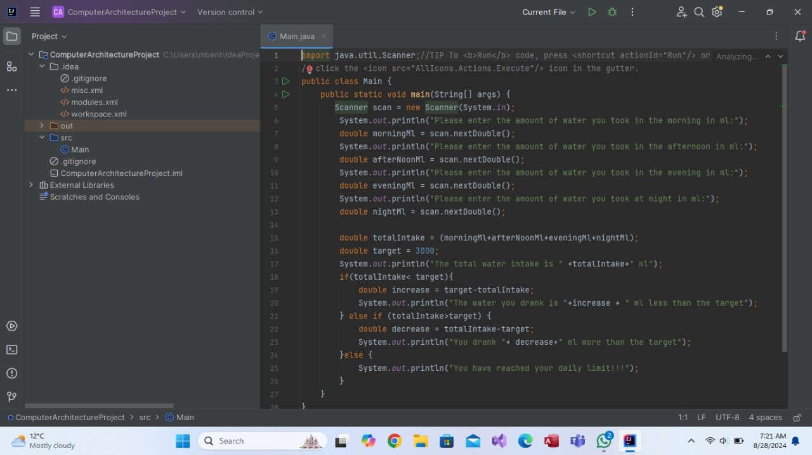

Slide 9
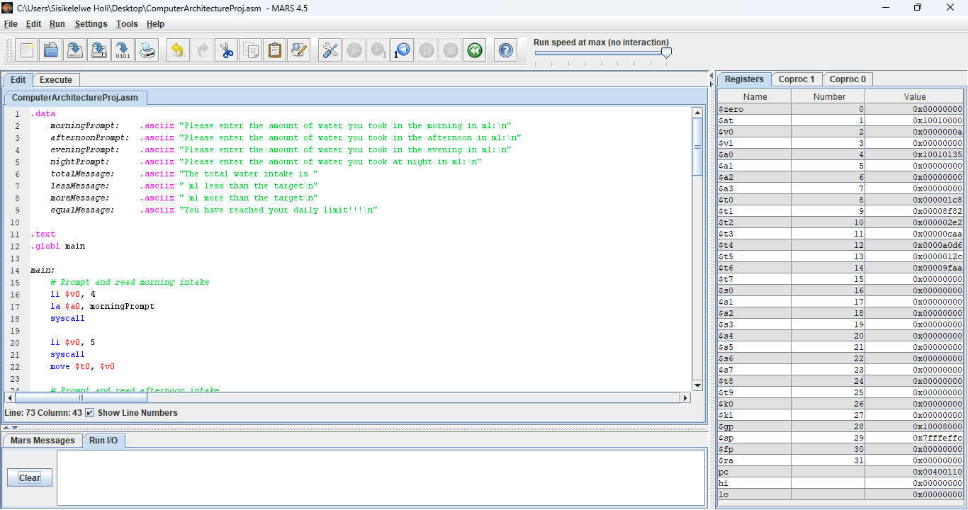

Slide 10
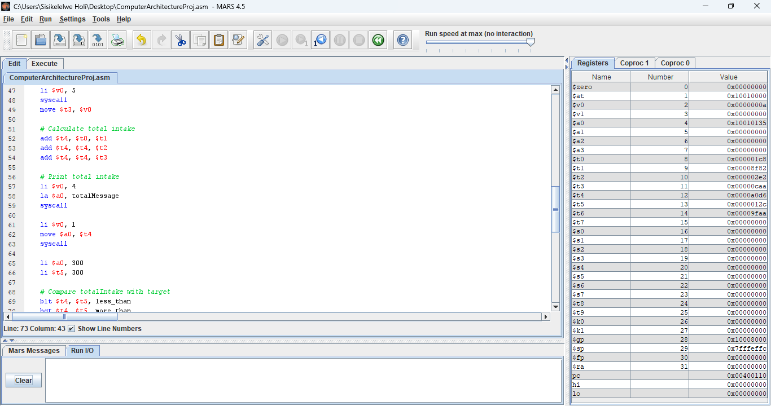

Slide 11
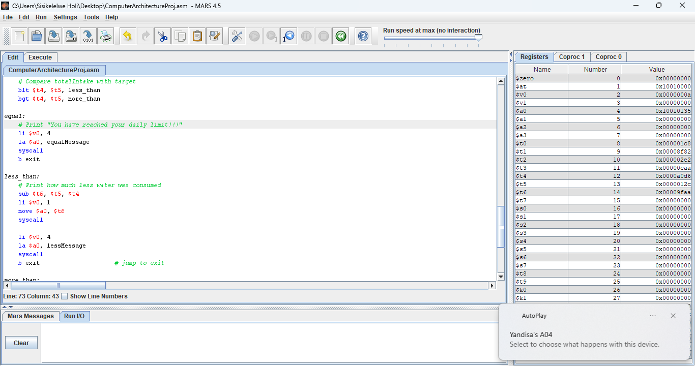

Slide 12
